Slide 1

Deep Learning Group Project
Members: Roland Joseph Baja 301252375 Lewis Merino 822273553 Chitra Hajra Roy 301148774 Zeenath Razak 300591954

Slide 2


Description & Scope
Objective: The purpose of the notebooks in this repository is to explore the optimal methods for leveraging artificial neural networks in identifying Disaster Tweets. The project aims to employ natural language processing (NLP) techniques to classify tweets related to real disasters. By constructing and evaluating various deep learning models, the project seeks to achieve accurate sentiment analysis, which is crucial for effective crisis communication and response strategies.
Platform: This project is hosted on Kaggle, a renowned platform for data science competitions, datasets, and tutorials. Kaggle fosters collaboration and innovation in the fields of machine learning and analytics, providing resources for practitioners to develop and showcase their skills.
Task Focus: The primary focus of this project is on natural language processing (NLP) techniques. Specifically, the project aims to classify disaster-related tweets through sentiment analysis. By analyzing the text content of tweets, the project seeks to identify patterns and sentiments indicative of real disasters, contributing to advancements in crisis management and social media analytics.

Slide 3

Dataset Info
Dataset Name: Disaster Tweets Content: Tweets with text, keyword, location, and target label indicating real disaster relevance.
Purpose: Train ML models to classify tweets for disaster detection, aiding crisis management and emergency response.

Slide 4
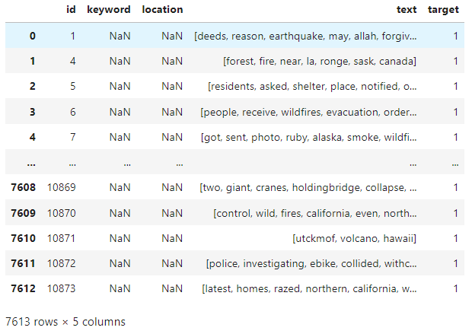
Data Exploration & Preprocessing
Summary:
Consist of 7613 rows
Has 5 column
Keyword and location is not relevant

Slide 5
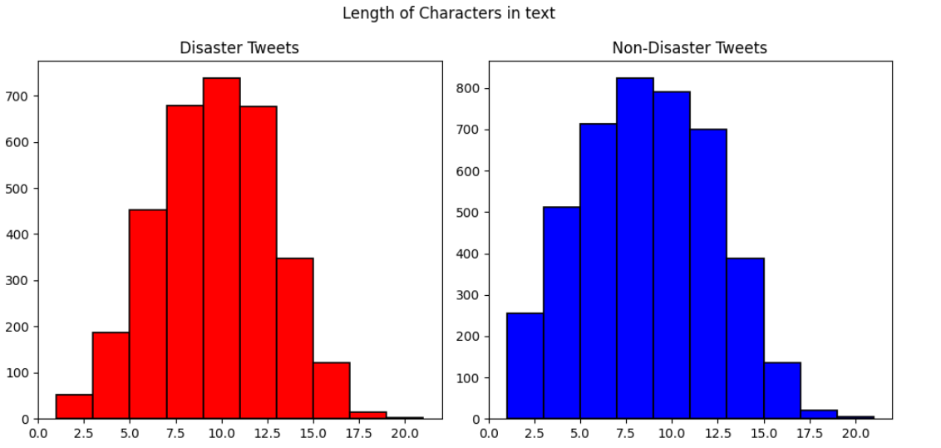
Data Exploration & Preprocessing

Slide 6
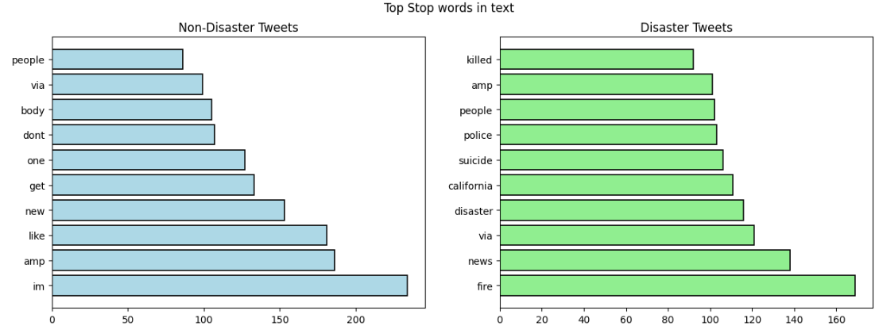
Data Exploration & Preprocessing

Slide 7
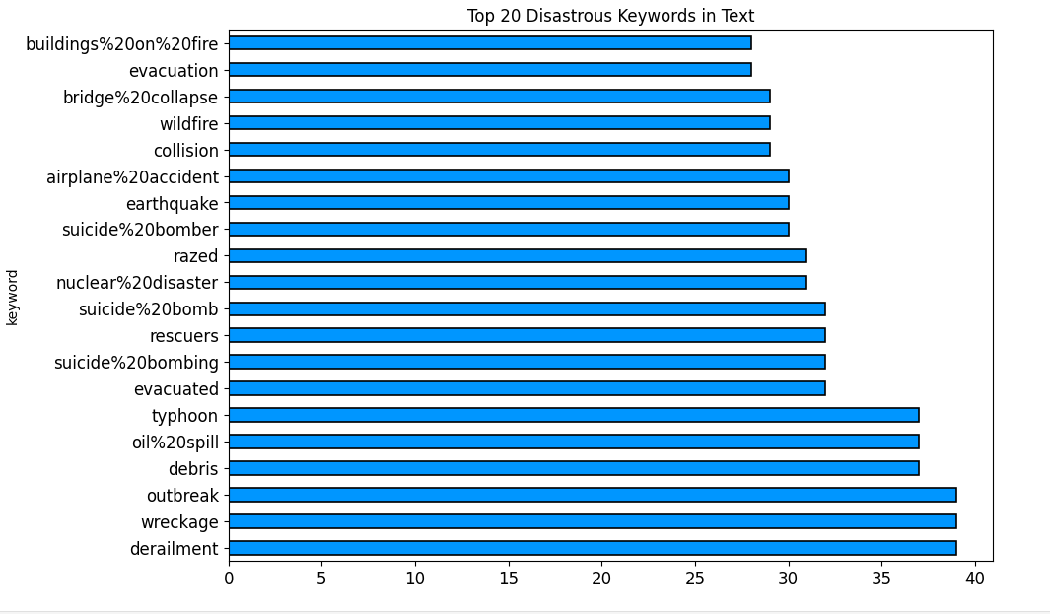
Data Exploration & Preprocessing

Slide 8
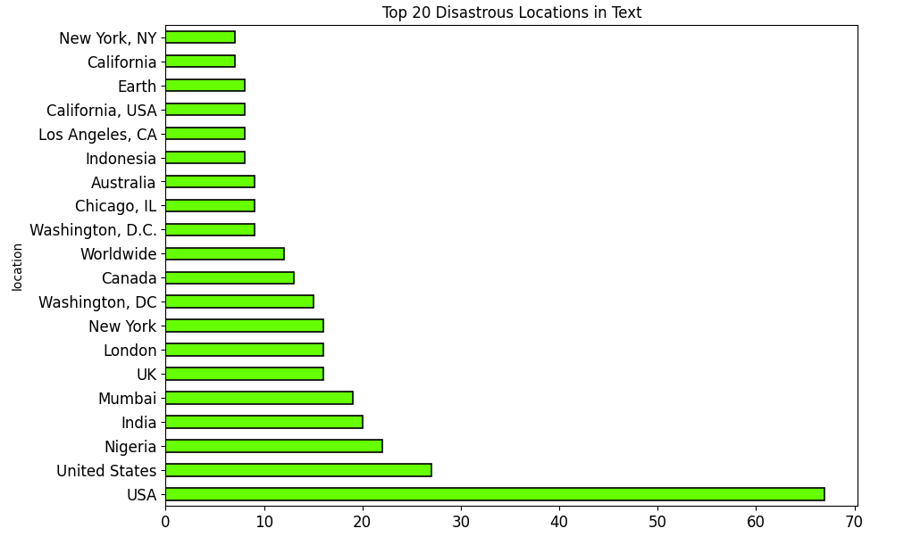
Data Exploration & Preprocessing

Slide 9




Data Exploration & Preprocessing
Split Ratio
Training Data
Validation Data
Testing Data
Traning:80%
Validation:20%
Testing:20%
X-train:7613
Y-train:7613
X-val:3263
Y-val:3263
X-test:3263
Y-test:3263

Slide 10

Methodologies
Supervised Learning
Unsupervised Learning
State of the art
Method: Employing a CNN model trained on labeled tweet data for disaster classification, utilizing tokenization, padding, and Keras for construction.
Objective: To create an effective predictive tool for accurately categorizing disaster-related tweets, facilitating crisis communication and response.
Method: Using Word2Vec embeddings trained on tweet data to initialize an Embedding layer in a CNN model, along with tokenization and padding for data preprocessing.
Objective: To leverage pre-trained word embeddings for tweet classification, enhancing the model's ability to capture semantic information and improve performance in disaster tweet detection.
Method: Utilizing an LSTM model with pre-trained Word2Vec embeddings for tweet classification, integrating tokenization, padding, and Keras for model construction and evaluation, with a focus on leveraging sequential information for accurate disaster tweet detection.
Objective: To exploit advanced recurrent neural networks and pre-trained embeddings to effectively classify disaster-related tweets, achieving state-of-the-art performance in crisis communication and response tasks.

Slide 11
Results and Analysis
Supervised Learning
Validation Accuracy = 0.7531188726425171
Testing Accuracy = 0.5865767698437021
Unsupervised Leaning
Validation Accuracy =0.4832567274570465
Testing Accuracy = 0.2549800796812749
State of the Art
Validation Accuracy = 0.5508863925933838
Testing Accuracy = 0.8810910205332516
Supervised Learning: Achieves a validation accuracy of 0.753 and a test accuracy of 0.587. It performs significantly better than unsupervised learning and comparably to the state-of-the-art model.
Unsupervised Learning: Shows lower performance with a validation accuracy of 0.483 and a test accuracy of 0.255. This indicates that it struggles to generalize well to unseen data.
State of the Art: Demonstrates a validation accuracy of 0.551 and a notably higher test accuracy of 0.881. This indicates superior performance, especially on unseen data, compared to both supervised and unsupervised approaches.

Slide 12
Confusion Matrix VS ROC Curve
Confusion Matrix
Color: Different shades of blue are used to represent the number of predictions in each category, with darker shades indicating higher counts.
Number: Each cell in the matrix contains a numerical value representing the count of predictions.
Interpretation: The matrix helps assess the model's performance by showing true positives (correct positive predictions), true negatives (correct negative predictions), false positives (incorrect positive predictions), and false negatives (incorrect negative predictions). It's a visual tool for understanding where the model excels and where it needs improvement.
ROC Curve
Color: The ROC curve itself is typically depicted in orange, while the diagonal line (representing random guessing) is shown in navy blue.
Interpretation: The curve illustrates the trade-off between the true positive rate (sensitivity) and the false positive rate (1 - specificity) as the classification threshold varies. A higher curve (closer to the top-left corner) indicates better model performance, while the diagonal line represents random guessing.
Area Under the Curve (AUC): The area under the ROC curve (AUC) quantifies the overall performance of the model. A higher AUC value (closer to 1) indicates better discrimination ability.

Slide 13

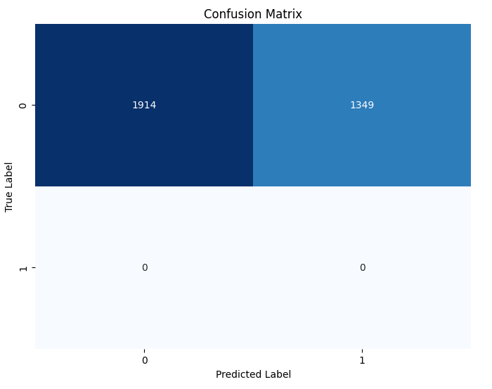
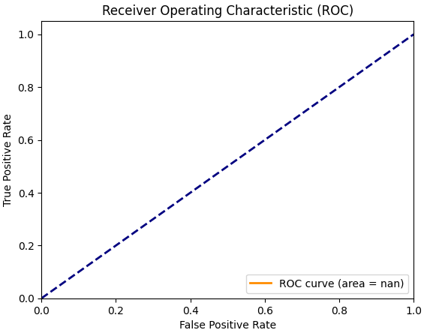
Supervised Learning Results

Slide 14
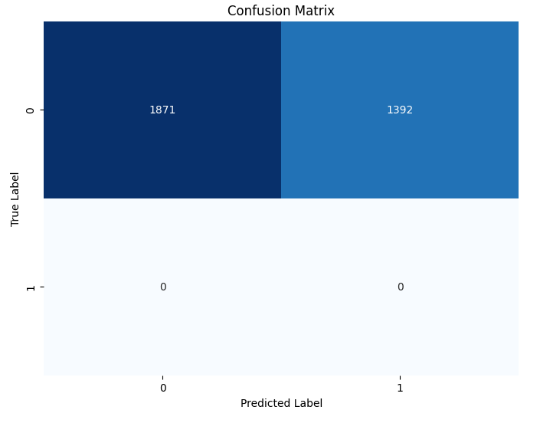
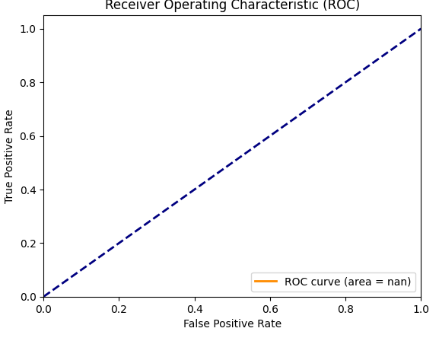
Unsupervised Learning Results

Slide 15
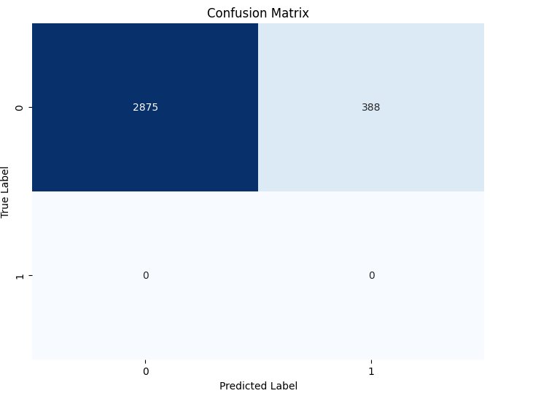
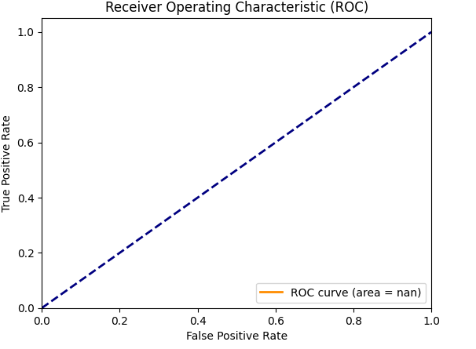
State of The ArT Results

Slide 16
Technical Challenges
Supervised Learning: Achieves relatively good validation and test accuracies, but there might be concerns about overfitting or the model's generalization capability, especially considering the disparity between validation and test accuracies.
Unsupervised Learning: Faces challenges in accurately capturing the underlying patterns or structures in the data, leading to lower validation and test accuracies compared to supervised learning. The model might struggle to identify meaningful features without labeled data.
State of the Art: While the model exhibits high performance in terms of validation and test accuracies, potential challenges could include maintaining scalability and efficiency, as well as addressing the risk of model complexity, given the significantly higher test accuracy compared to other approaches. Additionally, ensuring robustness to various real-world scenarios and datasets could be another technical challenge.

Slide 17

Thank You

